Slide 1


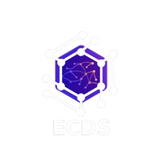


ECDS
NEST -
Networked Escrow for
Secure Transactions
Your funds, safely nested.
TEAM NAME: Runtime

Slide 2
ECDS
GUIDELINES
GitHub Submission: Submit your GitHub repository 8 hours before final evaluation.
Deployment: Deploy the complete project repository (frontend deployment optional).
Plagiarism Check: All submissions will undergo plagiarism verification.
Pitch Format: Round 1 & Round 2 will include a 7-minute project pitch + evaluation.
Team Requirement: Minimum 3 team members must be present during evaluation.

Slide 3
ECDS
PROBLEM STATEMENT
Infrastructure and transportation logistics often face payment disputes, delayed settlements, and lack of transparency between customers and suppliers. Traditional systems rely on manual verification of delivery records, leading to inefficiencies, mistrust, and payment delays.
Therefore, a secure and automated payment mechanism is needed to ensure payments are released only after successful delivery confirmation.
Objective:
Design and implement a smart contract based escrow payment system that:
Locks payment securely when an order is placed
Releases payment automatically after delivery confirmation
Provides transparent and tamper proof payment tracking using blockchain
This system aims to improve trust, reduce disputes, and automate payment settlements in transportation and infrastructure services.

Slide 4
ECDS
OUR SOLUTION
Develop a Blockchain based Smart Contract Escrow Payment System for transportation and logistics services.
Customer payments are securely locked in a smart contract escrow when an order is placed.
The driver completes the delivery and submits proof of delivery through the mobile application.
The customer verifies the delivery using confirmation methods such as QR Delivery Confirmation.
Once delivery is confirmed, the smart contract automatically releases payment to the driver or supplier.
All transactions are recorded on blockchain for transparency and trust.

Slide 5








ECDS
Our Features
Escrow Smart Contract Payment
Automatic Payment Release
Blockchain Transaction Tracking
Razorpay Payment Integration
Smart Contract Delay Penalty
Multi-Stage Payment Support
AI Fraud Detection
Driver & Supplier Reputation Score

Slide 6
ECDS
INNOVATION & USP
Secure OTP / QR Delivery Confirmation – prevents fake delivery completion by verifying with customer OTP or QR code.
Real-Time Delivery Tracking Interface – customers can track driver movement and delivery progress live.
Escrow Transparency Dashboard – admin panel displaying blockchain transaction hashes and payment status.
Address Confidence Score (AI) – predicts delivery success using address completeness, driver history, and location accuracy.
Driver Feedback & Address Improvement System – drivers can report difficult locations to improve future deliveries.
Smart Location Verification System – uses GPS pin drop and live location sharing to ensure accurate delivery locations.

Slide 7
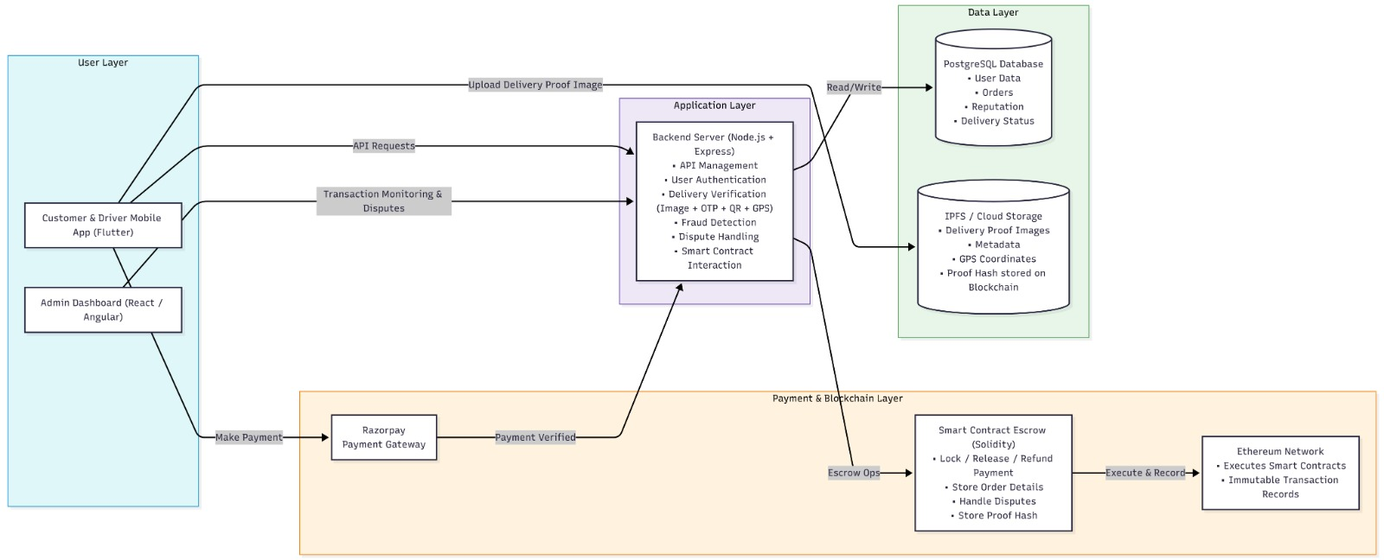
ECDS
WORKFLOW DIAGRAM WITH TECH STACK

Slide 8
ECDS
Tech Stack
Admin Dashboard
* Angular / React
Database (Off-chain Storage)
* PostgreSQL
File Storage
* IPFS / Cloud Storage (Delivery Proof Images)
Payment Gateway
* Razorpay
Authentication & Security
* JWT Authentication
* OTP Verification System
Blockchain Layer
* Ethereum (Testnet – Sepolia)
* Solidity Smart Contracts
* Hardhat (Smart Contract Development)
Backend
* Node.js
* Express.js
Blockchain Integration
* Ethers.js / Web3.js
Mobile Application
* Flutter (Customer & Driver App)

Slide 9
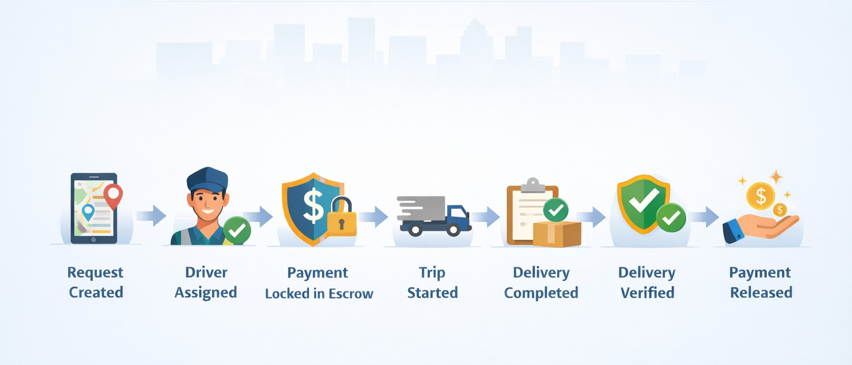
ECDS
Lifecycle of a transportation order

Slide 10
ECDS
TEAM MEMBERS
Manan Dudeja – 24BCE1270
Arnav Thapliyal – 24BCE1799
Akshat Singh – 24BCE1278
Tanushree Adhikari – 24BCE1439

